Slide 1

The Features and Uses of Computer Networking
Task 1

Slide 2
The uses and features of two different computer networks:
Investigate two different kinds of computer network to discuss Strengths and weaknesses of both.
The features of computer network requires to allow to people to play games simultaneously is a multi-players gaming environment.

Slide 3
Difference between wired and wireless connections :
Wired connection
+A wired network employs wires to link devices to the Internet or another network, such as laptops or desktop PCs.
- Example: In the networking world, “Wired” as the name suggests refers to any physical medium connected through wires and cables. The wires/cables can be copper wire, twisted pair or even fibre optic. Wired connectivity is responsible for providing high security with high Bandwidth provisioned for each user.
- In fact, Wired connectivity is considered highly reliable and incurs very low delay, unlike Wireless connectivity.
Wireless connection
+Wireless Network Connections: “Wireless” means without wire, media that is made up of electromagnetic waves (EM Waves) or infrared waves. Antennas or sensors will be present on all wireless devices.
- Example: Cellular phones, wireless sensors, TV remotes, satellite disc receivers, and laptops with WLAN cards are all examples of wireless devices. For data or voice communication, a wireless network uses radiofrequency waves rather than wires.
- Though wireless connectivity is less secured and higher delay than wired connectivity, it is still preferred communication technology for customers. Wireless also earns low Installation cost in contrast to wired connectivity.

Slide 4

Investigate two different kinds of computer network to discuss Strengths and weaknesses of both.
Increasingly, the needs of modern homes and workspaces are for greater and more versatile internet coverage than just having a single PC, or group of PCs wired up to a router with ethernet cables.
Wireless networks enable multiple devices to use the same internet connection remotely, as well as share files and other resources.
LAN is the ‘Local Area Network.’ As the name suggests, it works to connect local computers.
WLAN is ‘Wireless Local Area Network.’ Wireless means connection without physical wire.
Next page

Slide 5
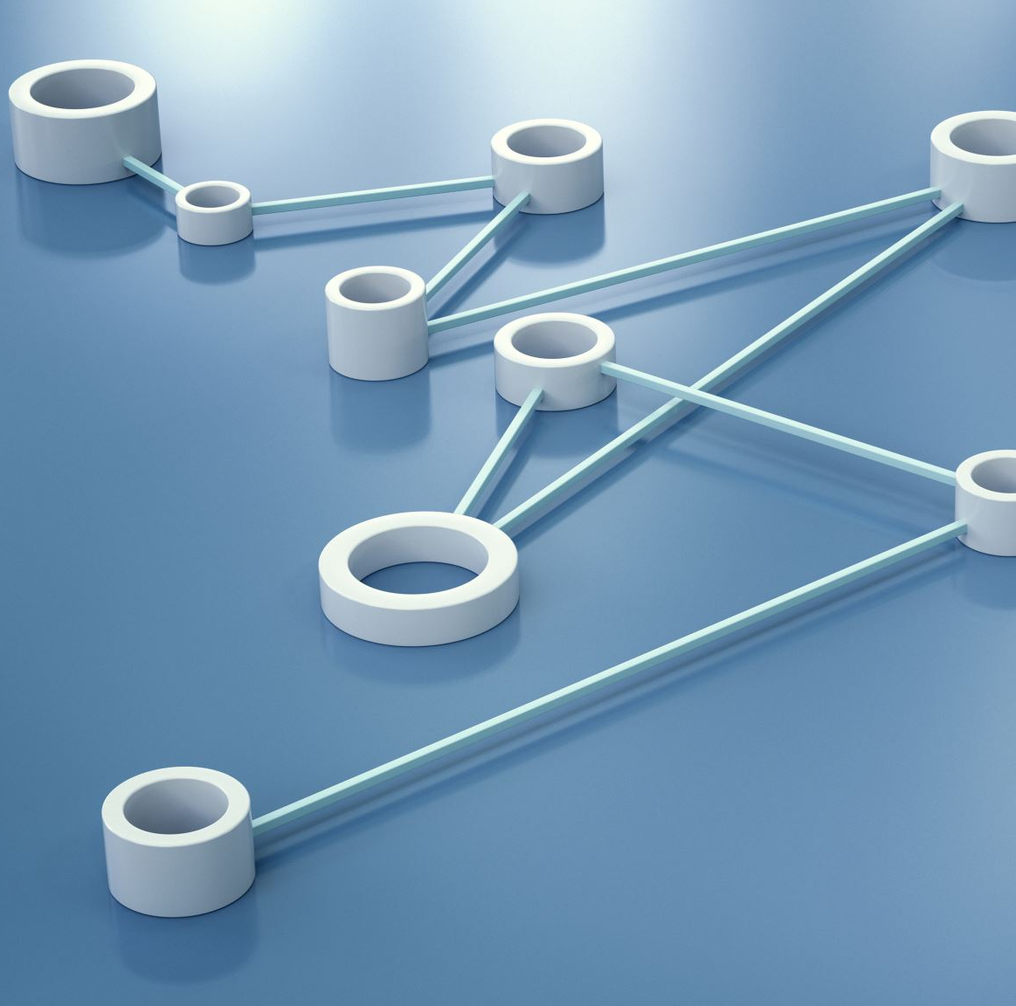
LAN Advantage:
Simple and relatively inexpensive: The primary benefit of a local area network is that this is quick and easy to set up and reasonably priced when contrasted to other alternatives; consequently, if an organization intends to build a network at a minimal price and with flexibility, a local area network is the ultimate answer.
Fast communication: LAN-connected systems or devices communicate directly at very high rates of speed, based on the LAN model and ethernet cabling installed. The most prevalent enabled speeds are 10 Mbps, 100 Mbps, and 1000 Mbps. Technologies of gigabit ethernet are quickly developing. Once the technology becomes more sophisticated and large-scale production has commenced, lower-cost variants will be accessible to the public.

Slide 6
LAN Disadvantage:
All devices may be disproportionately affected if the server fails: If a file on the server gets heavily damaged or a hard disc crashes, all the linked PCs will have extreme difficulty operating correctly.
Long-distance major limitation: Local area networks are often devised within a building or apartment complex and cannot be stretched to a bigger area.

Slide 7
WLAN Advantage:
Wireless networks can sometimes handle a larger number of users because they are not limited by a specific number of connection ports.
As WLAN reduces physical wires so it is a flexible way of communication.
It provides high data rate due to small area coverage.
The direction of connectivity can be anywhere i.e. you can connect devices in any direction unless it is in the range of access point

Slide 8
WLAN Disadvantage:
File-sharing transfer speeds are normally slower with wireless networks than they are with cabled. The speeds can also vary considerably according to your location in relation to the network.
WLAN uses frequency which may interfere with other devices which use frequency.
Signals could also be suffering from the environment as compared to using fiber optics.

Slide 9
LAN Action Plan
Item | Type | Reaction | Date | Security
Connectivity | LAN | Connected without error | 07/02/2023 | ManageEngine Firewall Analyzer Software
Reliability | UDP | Reliable | 07/02/2023 | ManageEngine Firewall Analyzer Software
Download Speed | Mbps | 635.9 | 07/02/2023 | ManageEngine Firewall Analyzer Software
Upload Speed | Mbps | 177.0 | 07/02/2023 | ManageEngine Firewall Analyzer Software
Frequency | Core: 5.0 GHz band | Satisfying | 07/02/2023 | techsession.be
Performance | Gamer User | Excellent result | 07/02/2023 | User and password

Slide 10
WLAN Action Plan
Item | Type | Reaction | Date | Security
Connectivity | WLAN | Connected But A few Jamming | 07/02/2023 | ManageEngine Firewall Analyzer Software
Reliability | TCP | Reliable | 07/02/2023 | ManageEngine Firewall Analyzer Software
Download Speed | Mbps | 109.9 | 07/02/2023 | ManageEngine Firewall Analyzer Software
Upload Speed | Mbps | 99.0 | 07/02/2023 | ManageEngine Firewall Analyzer Software
Frequency | Core: 2.4 GHz band | Sufficient | 07/02/2023 | techsession.be
Performance | Gamer User | Convincing | 07/02/2023 | User and password

Slide 11
Strengths and weaknesses of our connection plan
LAN : The connection of LAN computer Network was Excellent!, But the speed will be change by user e.g., inP2P LAN connection, the speed will change with how each user, use the network for different graphics and games that will be affected the performance.
WLAN: The connection of WLAN computer Network was Sufficient!, How ever the connection frequency and connection Faced Jamming!, that will be affected the performance. But the speed will be affected by upload speed, and it can be disconnected if the speed be low and change by user e.g., inP2P WLAN connection the speed will change with how each user, use the network for different graphic and games.

Slide 12
SOURCE:
test speed - Google Search
Wireless LAN & WAN - Tech Session
User Datagram Protocol - Wikipedia
What do you mean by reliability of computer network? How it is provided? - Quora
https://www.computer-solutions.co.uk/chipdev/tcpwnw.html
https://www.computer-solutions.co.uk/chipdev/tcpwnw.html
https://www.pcwdld.com/access-management#wbounce-modal
https://ipwithease.com/wired-network-vs-wireless-network/
https://digitalworld839.com/types-of-networks-computer/

